Slide 1


Slide 2


高三年级英语学科
阅读理解C、D篇讲评
授课教师：刘璐 学校：人大附中
指导教师：栗瑞莲 刘璐霏 学校：海淀区教师进修学校

Slide 3
1
文本概况
目 录
2
文本解读及题目解析
CONTENTS
3
教学建议

Slide 4
01
文本概况

Slide 5
1.篇目字数与话题
篇目及字数 （含选项） | 26届期末 | 25届高考 | 24届高考 | 23届高考 | 22届高考
C篇 | 452+ 120 | 403+ 89 | 405+ 115 | 369+ 117 | 392+ 129
总计 | 572 | 492 | 520 | 486 | 521

Slide 6
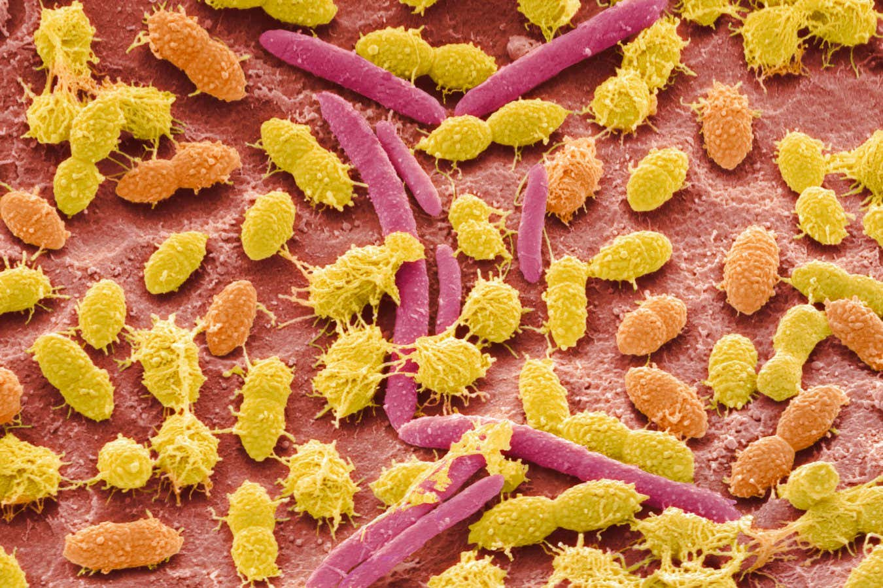
2. 篇目具体信息
篇目 | C篇
类型与主题 | 说明文（科学研究）
内容摘要 | 该文章报道了一项科学研究：研究人员将性格活跃与内向幼儿的肠道微生物移植给幼鼠，发现接受活跃型微生物的幼鼠探索行为更积极，而接受内向型微生物的幼鼠其大脑中与奖励相关的多巴胺神经元活性较低。这表明肠道微生物可能在早期发育中参与塑造行为倾向。

Slide 7
02
文本解读及题目分析

Slide 8
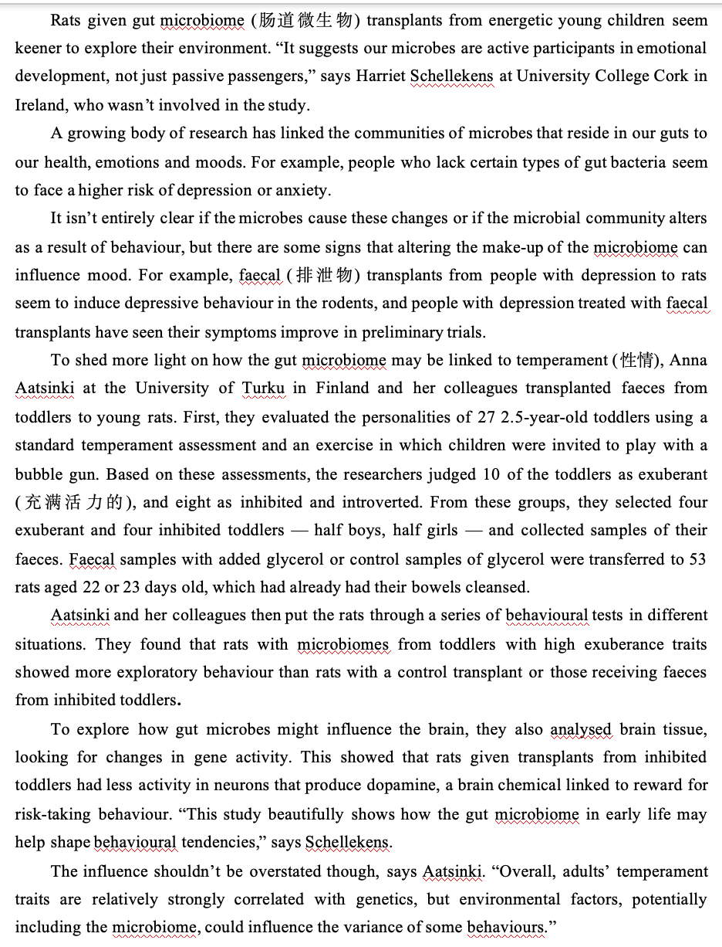

Para 1:
Introduction & Central Finding
Introduction
Para 2-3:
Research Background
Method
Para 4-6:
Aatsinki’s New Study: Detailed Methodology, Results & Analysis
Subjects
Sample Selection
Result(s)
Animal Model
Results: Behavioral Result+ Neurobiological Result
Discussion
IMaRD
Para 7 Discussion

Slide 9
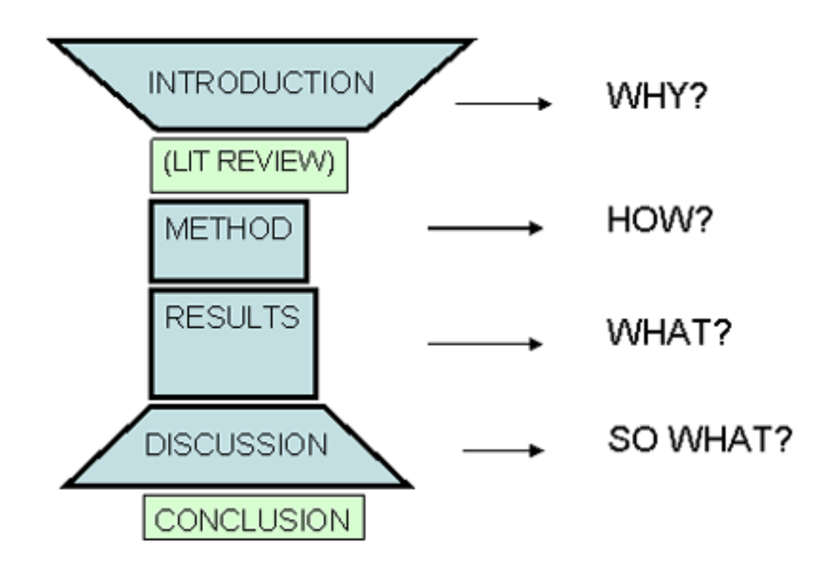
Internalize the Pattern
IMRaD, which stands for, Introduction & Importance, Methods, Results, and Discussion, is the format that scientists use when they write papers and/or articles. It is often used in healthcare and the natural sciences.

Slide 10
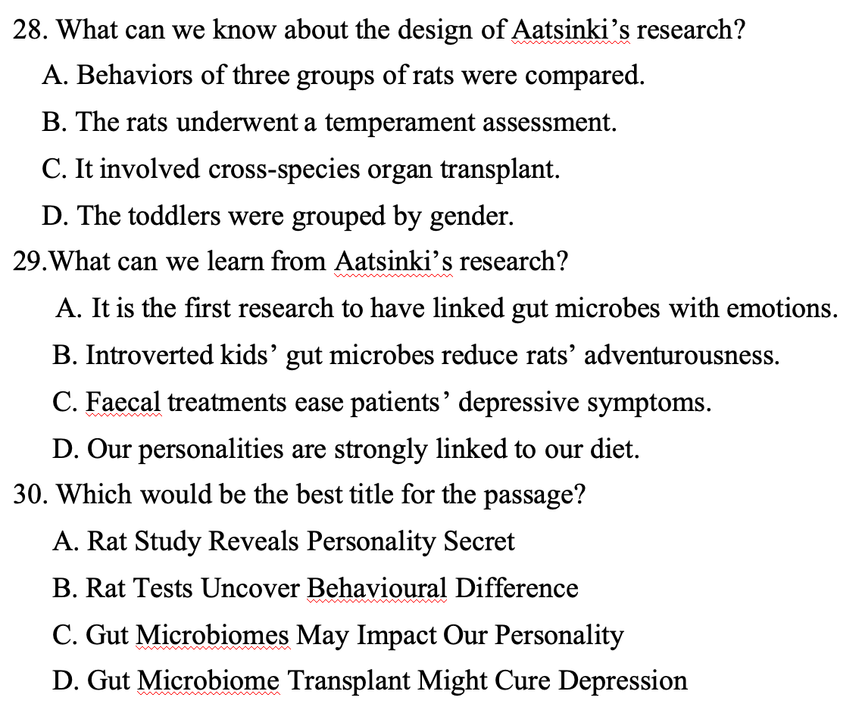
Para 1:
Introduction & Central Finding
Introduction
Para 2-3:
Research Background
Method
Method
Para 4-6:
Aatsinki’s New Study: Detailed Methodology, Results & Analysis
Result
Subjects
Sample Selection
Result(s)
Animal Model
Central Finding
Results: Behavioral Result+ Neurobiological Result
Discussion
Para 7 Discussion

Slide 11
题号 | 考察技能 | 学科能力
28 | 细节理解 （段落） | 获取信息
29 | 推理判断 （全文） | 分析推理
30 | 标题 （全文） | 获取主旨

Slide 12
28. What can we know about the design of Aatsinki’s research? A. Behaviors of three groups of rats were compared. B. The rats underwent a temperament assessment. C. It involved cross-species organ transplant. D. The toddlers were grouped by gender.
他们选取了四名外向活跃型和四名内向抑制型的幼儿——男女各半——并收集了他们的粪便样本。这些添加了甘油的粪便样本，或作为对照的纯甘油样本，被移植给了实验鼠。
To shed more light on how the gut microbiome may be linked to temperament (性情), Anna Aatsinki at the University of Turku in Finland and her colleagues transplanted faeces from toddlers to young rats. First, they evaluated the personalities of 27 2.5-year-old toddlers using a standard temperament assessment and an exercise in which children were invited to play with a bubble gun. Based on these assessments, the researchers judged 10 of the toddlers as exuberant (充满活力的), and eight as inhibited and introverted. From these groups, they selected four exuberant and four inhibited toddlers — half boys, half girls — and collected samples of their faeces. Faecal samples with added glycerol or control samples of glycerol were transferred to 53 rats aged 22 or 23 days old, which had already had their bowels cleansed.
Aatsinki and her colleagues then put the rats through a series of behavioural tests in different situations. They found that rats with microbiomes from toddlers with high exuberance traits showed more exploratory behaviour than rats with a control transplant or those receiving faeces from inhibited toddlers.
√
3 groups of rats--rats with:
(1) microbiomes from toddlers with high exuberance traits 接受活跃特质幼儿微生物组
(2) a control transplant 仅接受甘油（对照组）
(3) faeces from introverted and inhibited toddlers 接受“抑制型特质”（表现为谨慎退缩）幼儿微生物组
Notes:
glycerol ['glɪsərɒl] 甘油

Slide 13
28. What can we know about the design of Aatsinki’s research? A. Behaviors of three groups of rats were compared. B. The rats underwent a temperament assessment. C. It involved cross-species organ transplant. D. The toddlers were grouped by gender.
To shed more light on how the gut microbiome may be linked to temperament (性情), Anna Aatsinki at the University of Turku in Finland and her colleagues transplanted faeces from toddlers to young rats. First, they evaluated the personalities of 27 2.5-year-old toddlers using a standard temperament assessment and an exercise in which children were invited to play with a bubble gun. Based on these assessments, the researchers judged 10 of the toddlers as exuberant (充满活力的), and eight as inhibited and introverted. From these groups, they selected four exuberant and four inhibited toddlers — half boys, half girls — and collected samples of their faeces. Faecal samples with added glycerol or control samples of glycerol were transferred to 53 rats aged 22 or 23 days old, which had already had their bowels cleansed.
Aatsinki and her colleagues then put the rats through a series of behavioural tests in different situations. They found that rats with microbiomes from toddlers with high exuberance traits showed more exploratory behaviour than rats with a control transplant or those receiving faeces from inhibited toddlers.
√
张冠李戴
夸大性质 （扩缩范围）
曲解文意：分组的主要依据是性格特质（活跃/抑制）

Slide 14
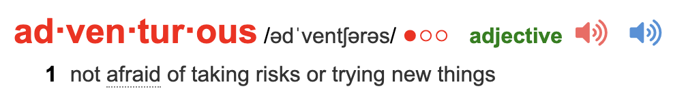
29.What can we learn from Aatsinki’s research? A. It is the first research to have linked gut microbes with emotions. B. Introverted kids’ gut microbes reduce rats’ adventurousness. C. Faecal treatments ease patients’ depressive symptoms. D. Our personalities are strongly linked to our diet.
与研究背景（第二段第一句）不符
√
不是Aatsinki研究内容
过度推断：没有提及肠道微生物与饮食的关联
(Para. 6) To explore how gut microbes might influence the brain, they also analysed brain tissue, looking for changes in gene activity. This showed that rats given transplants from inhibited toddlers had less activity in neurons that produce dopamine, a brain chemical linked to reward for risk-taking behaviour. “This study beautifully shows how the gut microbiome in early life may help shape behavioural tendencies,” says Schellekens.
gut microbes from inhibited and introverted toddlers transpanted
dopamine-related neurons become less active
less likely to take risks
Notes:
29 干扰项C

Slide 15
30. Which would be the best title for the passage? A. Rat Study Reveals Personality Secret B. Rat Tests Uncover Behavioural Difference C. Gut Microbiomes May Impact Our Personality D. Gut Microbiome Transplant Might Cure Depression
Rats given gut microbiome (肠道微生物) transplants from energetic young children seem keener to explore their environment. “It suggests our microbes are active participants in emotional development, not just passive passengers,” ...
A growing body of research has linked the communities of microbes that reside in our guts to our health, emotions and moods. For example, ...
...
To shed more light on how the gut microbiome may be linked to temperament (性情), Anna Aatsinki...
The influence shouldn’t be overstated though, says Aatsinki. “Overall, adults’ temperament traits are relatively strongly correlated with genetics, but environmental factors, potentially including the microbiome, could influence the variance of some behaviours.”
混淆研究方法与研究对象
√
研究贡献表述错误
全文围绕“肠道微生物是否以及如何可能影响性格（气质）”展开，通过介绍背景研究和详细阐述Aatsinki团队的老鼠实验，论证了这一观点。文章末段也谨慎地指出微生物是潜在的环境影响因素之一。因此，C选项“肠道微生物可能影响我们的性格”最全面、准确地概括了文章主旨。
Notes:
本题得分率较好

Slide 16
高考真题链接
41. Which would be the best title for this passage? （2020北京卷）
A. Craftsmen Set the Trends for Artists
B. Craftsmanship Leads to New Theories
C. Craftsmanship Makes Better Scientists
D. Craftsmen Reshape the Future of Science
34．Which would be the best title for this passage? （2024北京卷）
A．Virtues: Bridges Across Cultures
B．The Values of Self-discipline
C．Brains: Walls Against Chaos
D．The Roots of Morality
说明文的标题要准确、严谨地表达语篇的说明对象；科学研究类说明文，对于研究贡献（应用方向）的表述更要精准

Slide 17
01
文本概况

Slide 18
D篇 议论文
1.篇目字数与话题
 | 2022年 | 2023年 | 2024年 | 2025年 | 2026海淀期末
体裁 | 议论文 | 论说文 | 说明文 | 说明文 | 议论文
字数 | 388+129 | 425+149 | 390+120 | 401+123 | 446+131
题材 | 科技 | 科技 | 社会科学 | 科普（心理学） | 科技
试题题型 | 作者态度 细节理解 词义猜测 主旨大意（标题） | 作者态度 词义猜测 细节理解 主旨大意（标题） | 细节理解 细节推断 主旨大意（标题） | 推理判断 推理判断（观点） 写作目的 主旨大意 | 推理判断 推理判断（观点） 词义猜测 写作目的
文本特点 | 引用两位物理学家的观点，论述量子计算机是否能获得成功 | 通过举例和引用论证的方式，讨论Alife存在和发展的必要性 | 以因纽特人的生活为范例，介绍人类道德规范的起源，并分析背后的心理机制 | 以约翰逊的“人生故事模型”为范例，介绍自我认同的心理建构过程，并分析其与幸福感的关联机制 | 以哈勃深场和卡西尼号的意外发现为范例，论述科学探索中偶然性的核心价值，并批判现行科研资源分配机制对突破性发现的潜在抑制

Slide 19
2. 篇目具体信息
语篇类型 | 议论文
主要内容 | 以哈勃深场和卡西尼号的意外发现为范例，论述科学探索中偶然性的核心价值，并批判现行科研资源分配机制对突破性发现的潜在抑制
选材意义 | 探讨科学方法论，反思现行科研范式对于突破性发现的潜在制约
出处 | New Scientist, March 2024

Slide 20
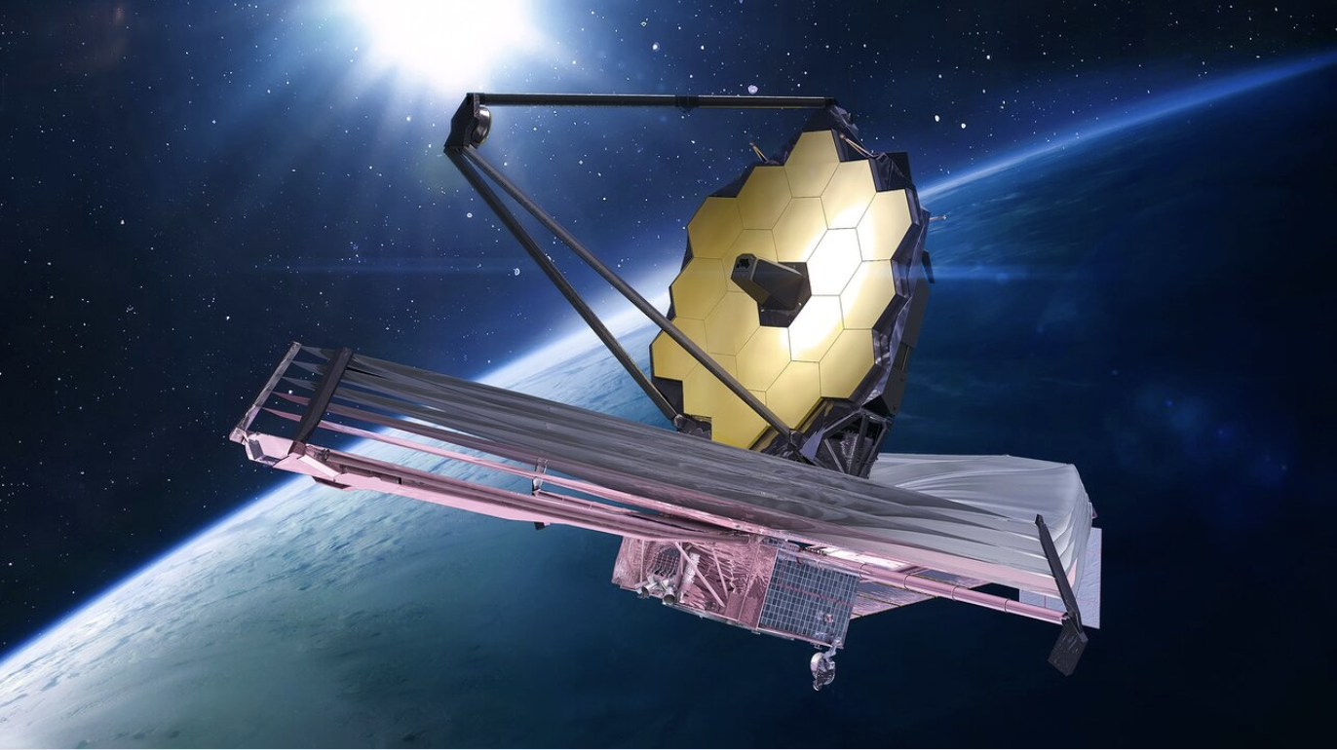
James Webb Space Telescope, launched in 2021, is NASA's premier infrared space observatory. It cost approximately $10 billion in total. 詹姆斯·韦伯空间望远镜于2021年发射升空，是美国国家航空航天局最先进的红外空间观测平台，其造价约100亿美元。

Slide 21
The Hubble Deep Field (HDF) is a landmark image of a tiny, seemingly empty patch of sky, captured by the Hubble Space Telescope in 1995. By staring at this single spot for over 100 hours, Hubble revealed thousands of previously unseen galaxies—some of the most distant ever observed. This one image revolutionized our understanding of the early universe, showing that galaxies are abundant and have evolved significantly over cosmic time. It remains one of the most important and iconic achievements in astronomy.
哈勃深场是哈伯太空望远镜于1995年针对天空中一个极微小、看似空无一物的区域所拍摄的标志性影像。通过对这一区域进行长达100多个小时的持续曝光，哈勃揭示了数千个此前从未被观测到的遥远星系，其中包含了一些宇宙诞生初期形成的星系。这张单一影像彻底改变了人类对早期宇宙的认知，证明了星系在宇宙中分布极为广泛，且随着宇宙年龄增长经历了显著的演化。至今，它仍被视为天文学史上最重要、最具代表性的科学成果之一。
哈勃太空望远镜目前仍在正常运行并执行科学观测任务。尽管比它更先进的詹姆斯·韦伯太空望远镜（JWST）已于2021年发射升空，但哈勃并未被取代或淘汰，而是与韦伯形成互补协作关系。

Slide 22
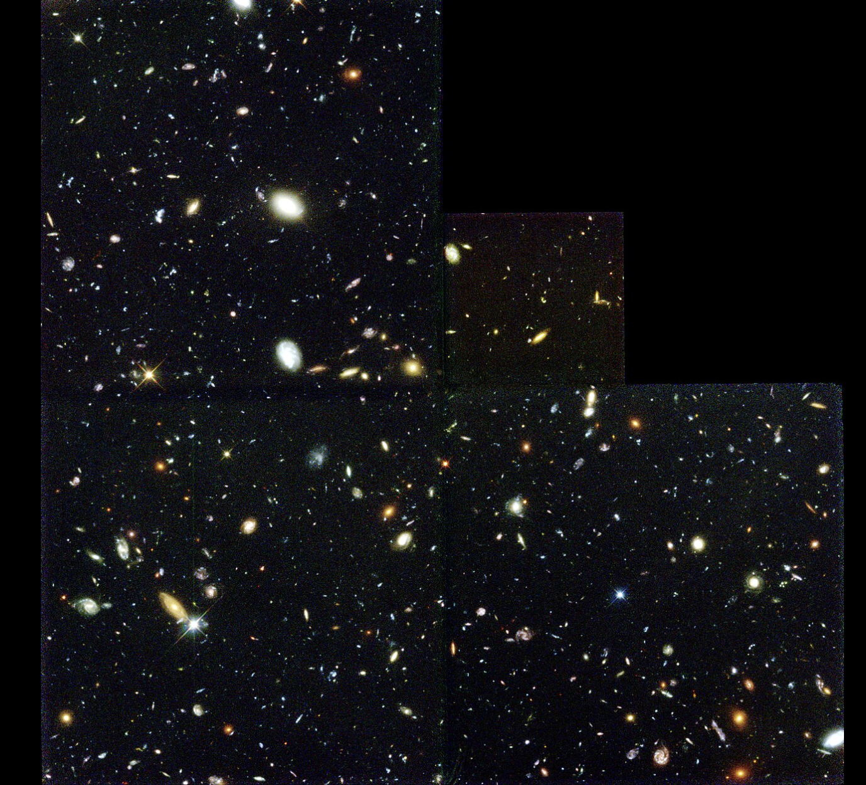
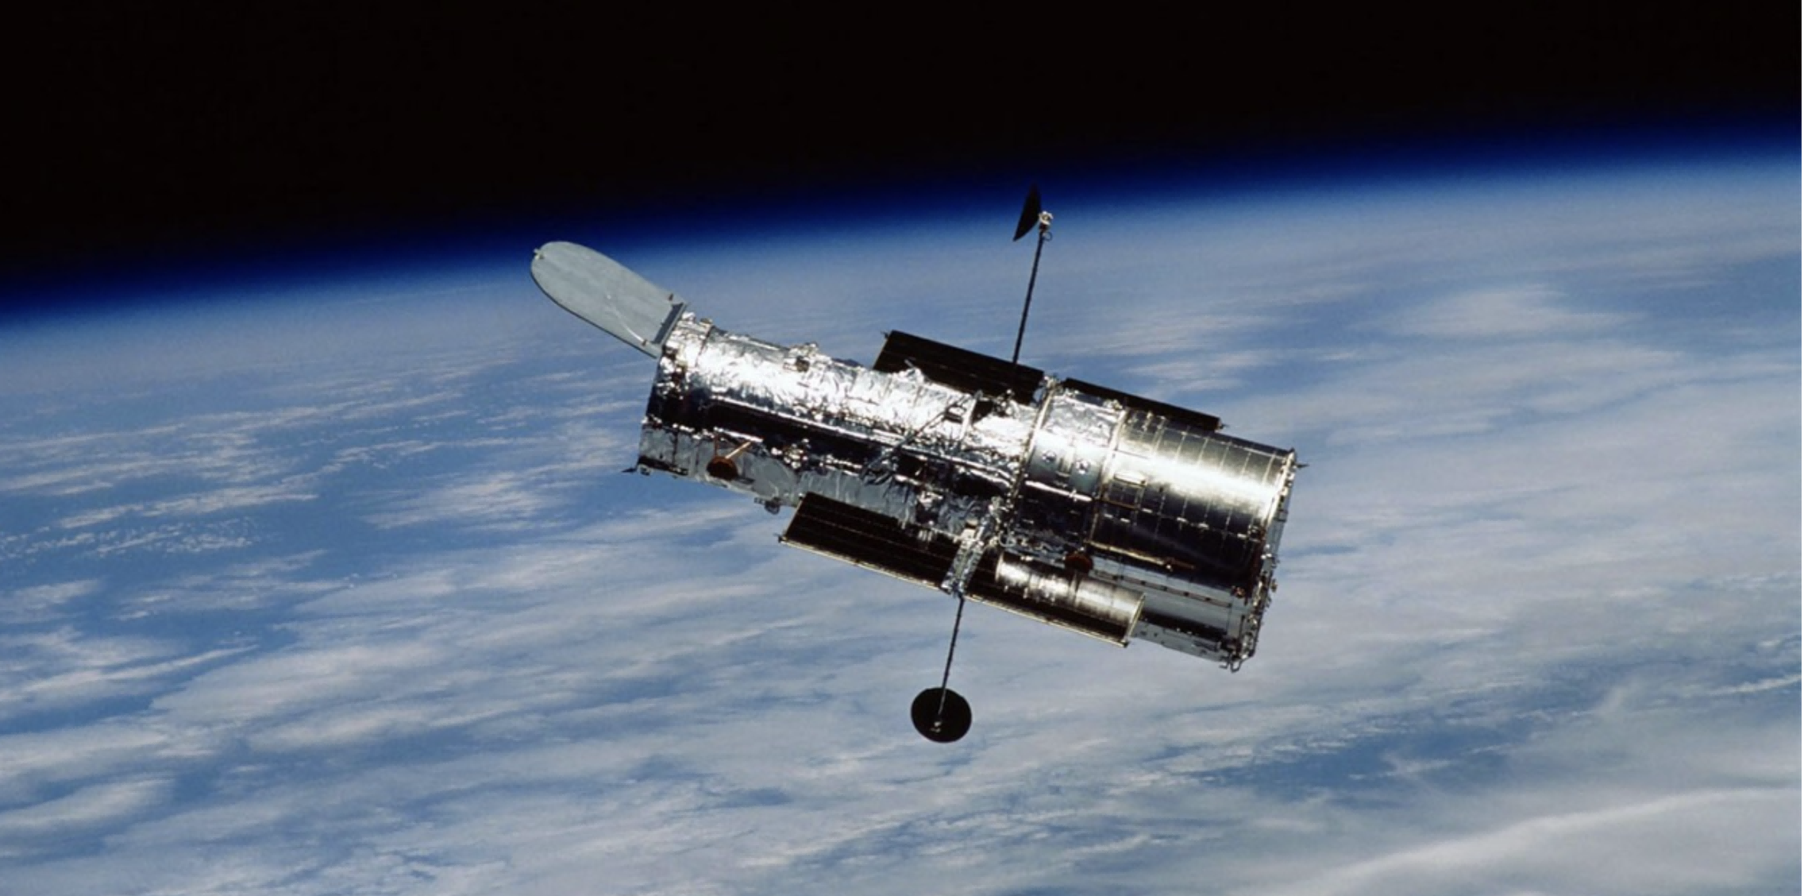
Hubble Deep Field, 1995
Hubble Space Telescope

Slide 23
02
文本解读及题目分析

Slide 24
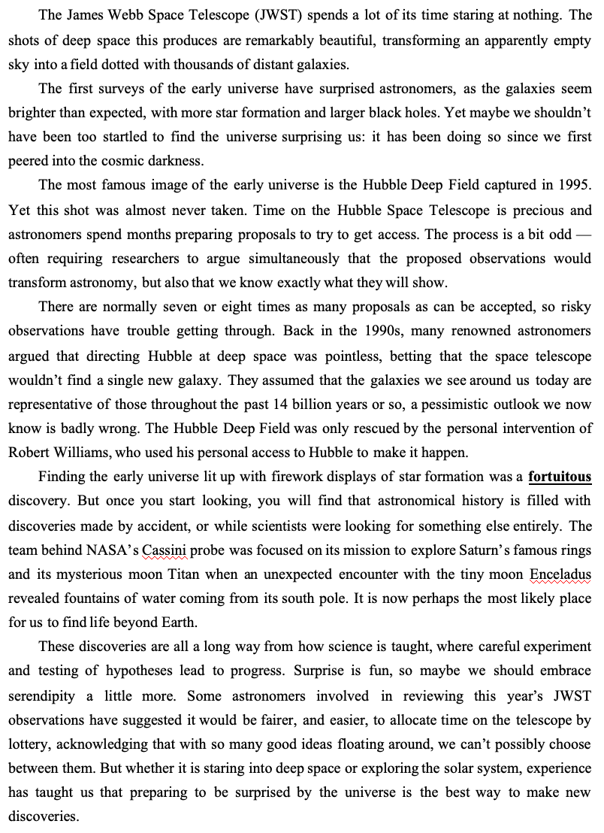
Para 1-2:
Specific Contemporary Observation--introducing the thesis that the universe consistently defies expectations.
Present Observation: thesis
Para 3-5:
Historical Evidences and Analysis
Argumentation: Past Evidences
Evidences: ① Hubble Deep Field project (3-4) ② Saturn's moon Enceladus (5)
Analysis: the gap between these serendipitous discoveries and the standard hypothesis-driven model
Argumentation: Critical Analysis
Call for Change
Para 6 Conclusion: A Call for Change

Slide 25
31. What can be inferred about JWST? A. It functions from time to time. B. It renews our knowledge of deep space. C. It surprises people more than Hubble does. D. It confirms previous assumptions of the universe.
The James Webb Space Telescope (JWST) spends a lot of its time staring at nothing. The shots of deep space this produces are remarkably beautiful, transforming an apparently empty sky into a field dotted with thousands of distant galaxies.
The first surveys of the early universe have surprised astronomers, as the galaxies seem brighter than expected, with more star formation and larger black holes. Yet maybe we shouldn’t have been too startled to find the universe surprising us: it has been doing so since we first peered into the cosmic darkness.
错误理解
√
无关比较
是非颠倒: 关注细节与文章主线逻辑(brighter, more star formation, larger black holes)
Notes:
只讲干扰项D

Slide 26
32. What does the writer think of the Hubble Space Telescope’s proposal process? A. It fails to leave much room for flexibility. 它未能为灵活性留出足够空间。 B. It favors proposals by renowned scientists. 它倾向于知名科学家的提案。 C. It leads to pessimistic views of the universe. 它导致了对宇宙的悲观看法。（强干扰） D. It ensures the most promising ideas get through. 它确保了最有前景的想法得以通过。
The most famous image of the early universe is the Hubble Deep Field captured in 1995. Yet this shot was almost never taken. Time on the Hubble Space Telescope is precious and astronomers spend months preparing proposals to try to get access. The process is a bit odd — often requiring researchers to argue simultaneously that the proposed observations would transform astronomy, but also that we know exactly what they will show.
There are normally seven or eight times as many proposals as can be accepted, so risky observations have trouble getting through. Back in the 1990s, many renowned astronomers argued that directing Hubble at deep space was pointless, betting that the space telescope wouldn’t find a single new galaxy. They assumed that the galaxies we see around us today are representative of those throughout the past 14 billion years or so, a pessimistic outlook we now know is badly wrong.
√
Notes:
强干扰项C

Slide 27
32. What does the writer think of the Hubble Space Telescope’s proposal process? A. It fails to leave much room for flexibility. B. It favors proposals by renowned scientists. 它倾向于知名科学家的提案。 C. It leads to pessimistic views of the universe. D. It ensures the most promising ideas get through.
The most famous image of the early universe is the Hubble Deep Field captured in 1995. Yet this shot was almost never taken. Time on the Hubble Space Telescope is precious and astronomers spend months preparing proposals to try to get access. The process is a bit odd — often requiring researchers to argue simultaneously that the proposed observations would transform astronomy, but also that we know exactly what they will show.
There are normally seven or eight times as many proposals as can be accepted, so risky observations have trouble getting through. Back in the 1990s, many renowned astronomers argued that directing Hubble at deep space was pointless, betting that the space telescope wouldn’t find a single new galaxy. They assumed that the galaxies we see around us today are representative of those throughout the past 14 billion years or so, a pessimistic outlook we now know is badly wrong.
favored renowned astronomers’ opinion, but not renowned scientists’ proposals
偷换概念
√

Slide 28
32. What does the writer think of the Hubble Space Telescope’s proposal process? A. It fails to leave much room for flexibility. B. It favors proposals by renowned scientists. C. It leads to pessimistic views of the universe. 它导致了对宇宙的悲观看法。 D. It ensures the most promising ideas get through.
The most famous image of the early universe is the Hubble Deep Field captured in 1995. Yet this shot was almost never taken. Time on the Hubble Space Telescope is precious and astronomers spend months preparing proposals to try to get access. The process is a bit odd — often requiring researchers to argue simultaneously that the proposed observations would transform astronomy, but also that we know exactly what they will show.
There are normally seven or eight times as many proposals as can be accepted, so risky observations have trouble getting through. Back in the 1990s, many renowned astronomers argued that directing Hubble at deep space was pointless, betting that the space telescope wouldn’t find a single new galaxy. They assumed that the galaxies we see around us today are representative of those throughout the past 14 billion years or so, a pessimistic outlook we now know is badly wrong.
√
reflected a pessimistic outlook, but not ‘leading to it’ 本末倒置

Slide 29
32. What does the writer think of the Hubble Space Telescope’s proposal process? A. It fails to leave much room for flexibility. B. It favors proposals by renowned scientists. C. It leads to pessimistic views of the universe. D. It ensures the most promising ideas get through. 它确保了最有前景的想法得以通过。
The most famous image of the early universe is the Hubble Deep Field captured in 1995. Yet this shot was almost never taken. Time on the Hubble Space Telescope is precious and astronomers spend months preparing proposals to try to get access. The process is a bit odd — often requiring researchers to argue simultaneously that the proposed observations would transform astronomy, but also that we know exactly what they will show.
There are normally seven or eight times as many proposals as can be accepted, so risky observations have trouble getting through. Back in the 1990s, many renowned astronomers argued that directing Hubble at deep space was pointless, betting that the space telescope wouldn’t find a single new galaxy. They assumed that the galaxies we see around us today are representative of those throughout the past 14 billion years or so, a pessimistic outlook we now know is badly wrong.
√
almost never taken; almost failed
是非颠倒

Slide 30
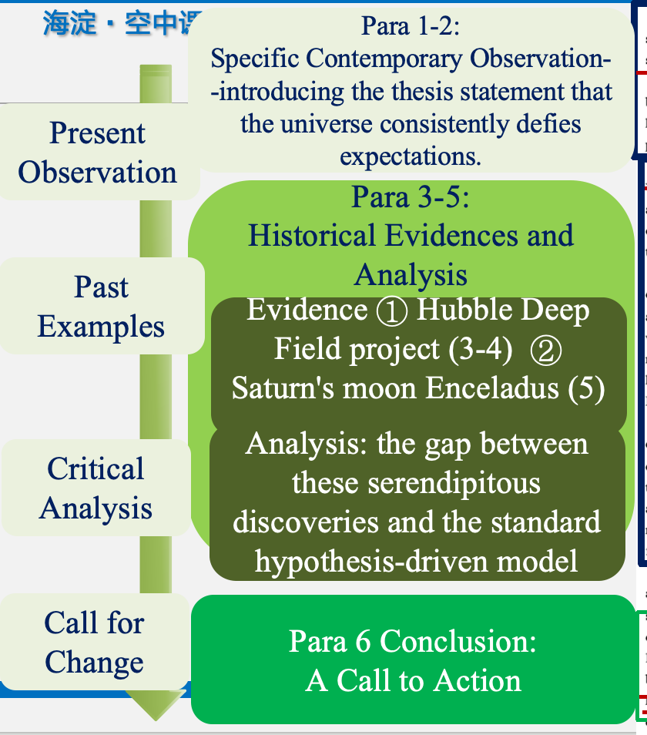
32. What does the writer think of the Hubble Space Telescope’s proposal process? A. It fails to leave much room for flexibility. B. It favors proposals by renowned scientists. C. It leads to pessimistic views of the universe. D. It ensures the most promising ideas get through.
The most famous image of the early universe is the Hubble Deep Field captured in 1995. Yet this shot was almost never taken. Time on the Hubble Space Telescope is precious and astronomers spend months preparing proposals to try to get access. The process is a bit odd — often requiring researchers to argue simultaneously that the proposed observations would transform astronomy, but also that we know exactly what they will show.
There are normally seven or eight times as many proposals as can be accepted, so risky observations have trouble getting through. Back in the 1990s, many renowned astronomers argued that directing Hubble at deep space was pointless, betting that the space telescope wouldn’t find a single new galaxy. They assumed that the galaxies we see around us today are representative of those throughout the past 14 billion years or so, a pessimistic outlook we now know is badly wrong.personal access to Hubble to make it happen.
反思干扰选项的特点、正答选项与文章主线主旨的关系，理解语篇中的“部分”与“整体”的关系--篇章整体阅读意识

Slide 31
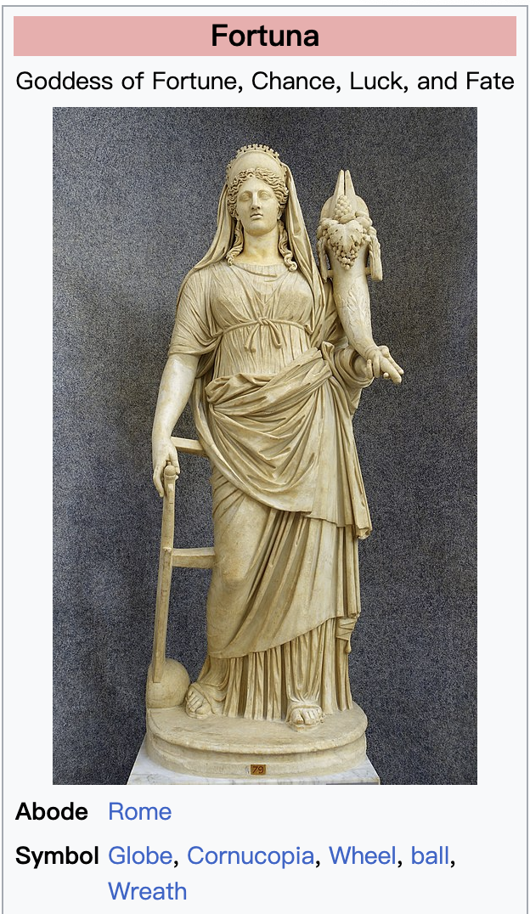
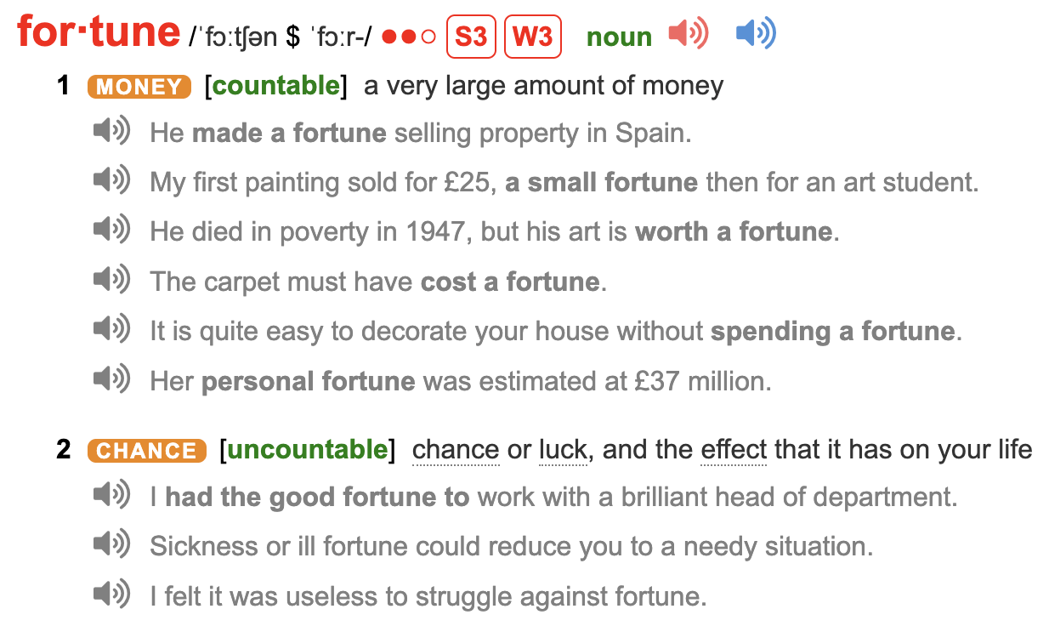
33. What does the underlined word “fortuitous” in paragraph 5 probably mean? A. Groundbreaking.(强干扰) B. Effortless. C. Chance. D. Plain.
Finding the early universe lit up with firework displays of star formation was a fortuitous discovery. But once you start looking, you will find that astronomical history is filled with discoveries made by accident, or while scientists were looking for something else entirely.
词义猜测：
1. 构词法分析
Notes:
选A的与选C的一样多

Slide 32
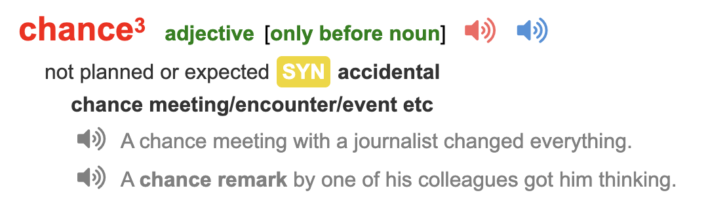
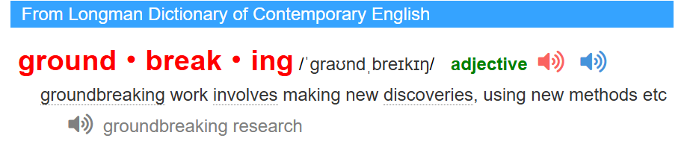
33. What does the underlined word “fortuitous” in paragraph 5 probably mean? A. Groundbreaking.(强干扰) B. Effortless. C. Chance. D. Plain.
Finding the early universe lit up with firework displays of star formation was a fortuitous discovery. But once you start looking, you will find that astronomical history is filled with discoveries made by accident, or while scientists were looking for something else entirely.
√
29. What does the word "nuances” underlined in Paragraph 2 most probably mean? (2025 北京)
A. Major achievements. B. Complex feelings.
C. Significant impacts. D. Fine differences.
词义猜测：
1. 构词法分析
2. 句内和句间逻辑
3. 全文主旨主线
28. What does the underlined word“germane”in Paragraph 3 probably mean？（2021 北京）
A. Scientific． B. Credible．
C. Original． D. Relevant
Notes:
选A的与选C的一样多

Slide 33
34. What does the author mainly do in this passage? A. Introduce space history. B. Examine a discovery. C. Balance opposing views. D. Encourage a mindset.
√

Slide 34
34题后教学活动建议--What mindset is encouraged in the text?
Preparing to be surprised by the universe is the best way to make new discoveries.
Groundbreaking science often comes from surprise and open-minded exploration, not just from planned, hypothesis-driven research.
We should embrace serendipity in scientific discovery.

Slide 35
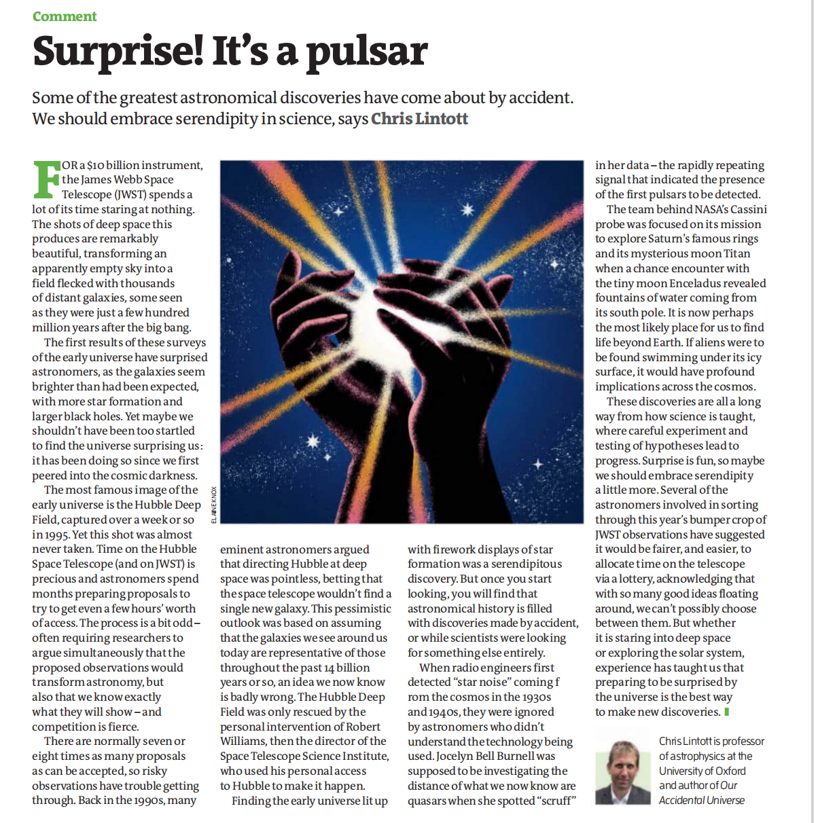
教学活动建议 Can you suggest a possible title for passage D? What message do you want to convey in it?

Slide 36
Title Story: Surprise! It’s a Pulsar
The title "Surprise! It’s a Pulsar （脉冲星）" is a brilliant, allusion-style headline that perfectly captures the article’s core argument, even though the term "pulsar" itself never appears in the text. It directly references one of the most famous serendipitous discoveries in astronomical history: in 1967, a graduate student named Jocelyn Bell Burnell detected an inexplicably regular radio signal while working on an unrelated project, which led to the completely unexpected discovery of pulsars—rapidly spinning neutron stars.
This iconic story of an accidental, revolutionary finding embodies the very essence of the article’s thesis: that groundbreaking science often comes from surprise and open-minded exploration, not just from planned, hypothesis-driven research. The title serves as the ultimate shorthand (简略的表达方式) and proof for the author’s call to embrace serendipity in scientific discovery.

Slide 37
Title Story: Surprise! It’s a Pulsar
1967年10月，剑桥大学卡文迪许实验室（Cavendish Laboratory）的安东尼·休伊什（Antony Hewish）教授的研究生——24岁的乔丝琳·贝尔·伯奈尔（Jocelyn Bell Burnell）检测射电望远镜收到的信号时无意中发现了一些有规律的脉冲信号，它们的周期十分稳定，为1.337秒。起初她以为这是外星人“小绿人”（LGM, Little Green Man）发来的信号，但在接下来不到半年的时间里，又陆陆续续发现了数个这样的脉冲信号。后来人们确认这是一类新的天体，并把它命名为“脉冲星”。
脉冲星的发现是20世纪天体物理学的重大突破，为其发现者赢得了诺贝尔奖（尽管贝尔的贡献在当时被严重低估）。而它被发现的过程，完全是计划外的、偶然的、令人惊喜的。

Slide 38
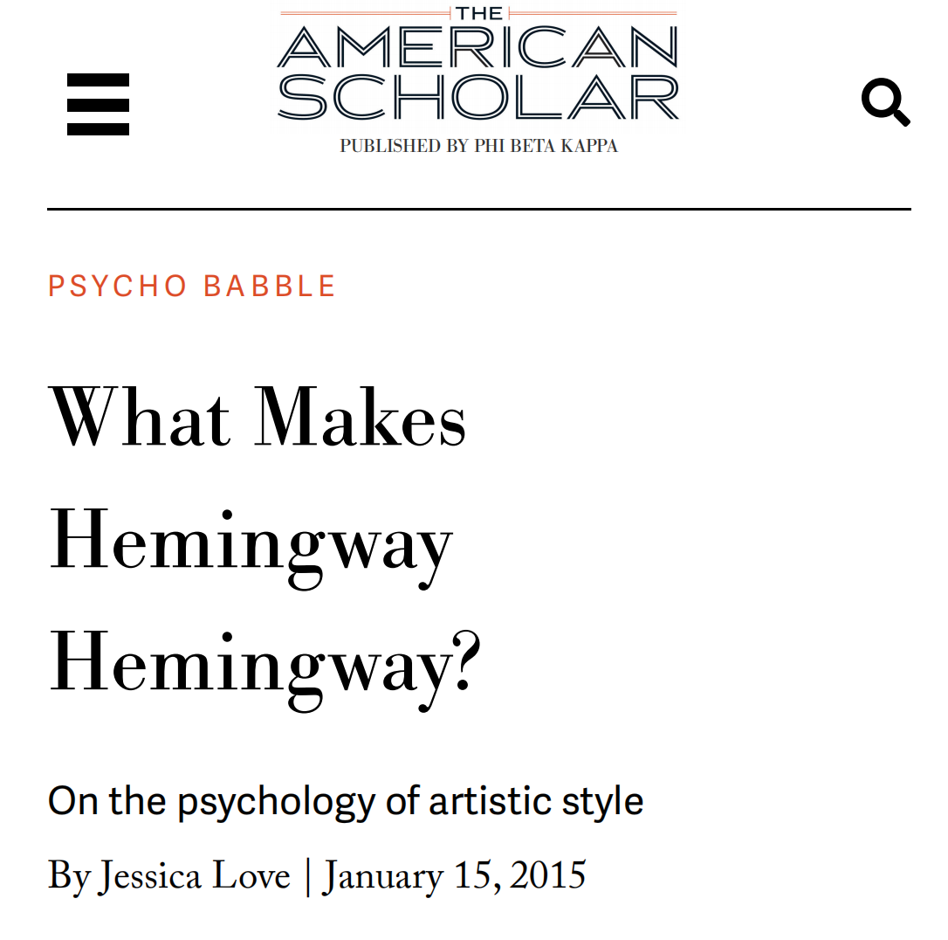
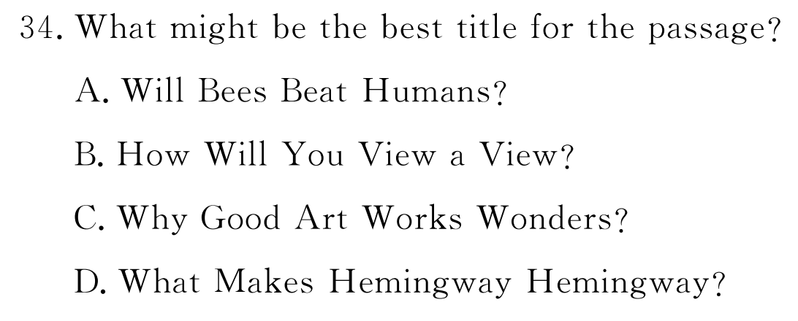
议论文标题--“传神”
传神--凝练表达作者主张
传神--兼以夹带作者文风
传神--不一定“传形” （不一定拘泥于关键词复现）
2025东城一模D

Slide 39
Example: To introduce space history 介绍太空历史
The launch of the Hubble Space Telescope in 1990 marked a new era. In 1995, it captured the iconic Deep Field image. A decade later, the Cassini probe began its mission to Saturn. These milestones form a linear progression of our technical capability. Each mission had predefined objectives and expanded our catalogue of celestial phenomena, steadily building the timeline of modern astronomy.

Slide 40
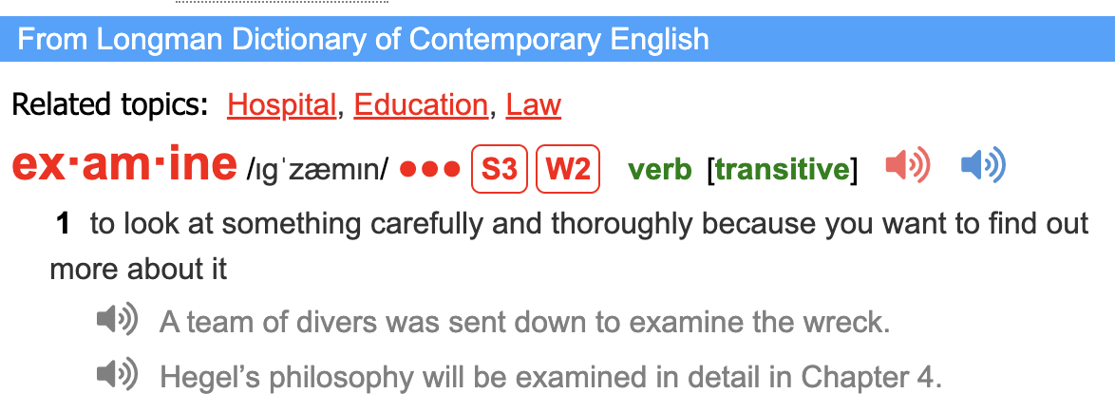
Example: To examine a discovery 审视一项发现
The Hubble Deep Field’s scientific validation involved rigorous analysis. We must scrutinize its data processing methods, the photometric redshift techniques used to estimate galaxy distances, and potential sources of bias, such as cosmic variance in that particular sky patch. The primary focus is on the technical credibility of this single finding and its specific implications for models of galaxy formation.

Slide 41
Example: To balance opposing views 平衡对立观点
Proponents of serendipity argue that major leaps, like the Deep Field, come from unplanned exploration. Conversely, proponents of hypothesis-driven science contend that structured inquiry, like the precise tests of general relativity, provides reproducible rigor. The former may lead to chaotic resource allocation, while the latter risks stifling creativity. A robust scientific ecosystem likely requires a deliberate balance between these two modes of investigation.

Slide 42
03
阅读教学建议

Slide 43
阅读素养：熟悉常见文体经典语篇结构，培养把握相应主旨的写作逻辑的意识和能力
阅读“活力”：与时俱进、广泛阅读、增加话题准备
阅读习惯：篇章整体阅读，深度学习，在把握主旨的基础上绘制语篇逻辑地图和梳理常见写作技巧

Slide 44
阅读微技能：课标词汇深度学习（词汇在语境中的灵活使用、派生词和一词多义等）、衔接手段、长难句及特殊句式
The shots of deep space this produces are remarkably beautiful, transforming an apparently empty sky into a field dotted with thousands of distant galaxies.
The first surveys of the early universe have surprised astronomers...
...it has been doing so since we first peered into the cosmic darkness.
The most famous image of the early universe is the Hubble Deep Field captured in 1995.
Some astronomers involved in reviewing this year’s JWST observations have suggested it would be fairer, and easier, to allocate time on the telescope by lottery...

Slide 45
语境中词汇的深度学习
The shots of deep space this produces are remarkably beautiful, transforming an apparently empty sky into a field dotted with thousands of distant galaxies.
The first surveys of the early universe have surprised astronomers...
...it has been doing so since we first peered into the cosmic darkness.
The most famous image of the early universe is the Hubble Deep Field captured in 1995.
Some astronomers involved in reviewing this year’s JWST observations have suggested it would be fairer, and easier, to allocate time on the telescope by lottery...
Yet this shot was almost never taken. (句式)
The process is a bit odd — often requiring researchers to argue simultaneously that the proposed observations would transform astronomy, but also that we know exactly what they will show. （句子理解）

Slide 46
阅读微技能：课标词汇深度学习（词汇在语境中的灵活使用、派生词和一词多义等）、衔接手段、长难句及特殊句式
阅读解题能力：题目类型化反思和整理

Slide 47
谢 谢！
本视频课程中的部分图片、视频引自有关图书、网络，特向这些图片、视频的制作者和有关图书的出版者和相关网络表示感谢；因多种原因，事先未与作者和出版社取得联系，特向他们表示歉意。

